Slide 1
Selected Topic of Computer Science

Slide 2
API : APPLICATON PROGRAMMING INTERFACE

Slide 3
What is an API?
Definition: An API, or Application Programming Interface, is a set of rules and specifications that allows software applications to communicate with each other.
Technical Explanation: APIs consist of functions, procedures, protocols, and data structures that enable software components to access services or resources.
Simplified Explanation: An API acts as a messenger, translating requests between different applications.

Slide 4
How does an API work?
Analogy: Think of an API as a waiter in a restaurant.
User/Application Interaction: You (one application) tell the waiter (API) what you want (data or functionality) through a request.
API Communication: The API relays the request to the appropriate application or service.
Response Delivery: The API brings back the response (such as data or results) from the application/service to your application.

Slide 5
Key Features and Benefits of APIs
Interoperability: Enables different applications to work together, regardless of technologies or languages.
Reusability: Provides reusable components, reducing development time.
Scalability: Handles increased traffic and user demands by distributing workload.
Third-Party Integration: Facilitates integration with external services for enhanced features.
Ecosystem Expansion: Empowers developers to build new applications and services, fostering innovation.

Slide 6
API Protocols: REST, SOAP, GraphQL
1. REST (REpresentational State Transfer)
Definition: REST is a lightweight and widely used protocol built on existing web standards like HTTP. It emphasizes resource-based communication, meaning data is accessed and manipulated as resources (like users, products, orders) with unique identifiers (IDs).
Advantage: Simplicity, wide support, stateless.
Disadvantage: Limited functionality, over-fetching, versioning.

Slide 7
API Protocols: REST

Slide 8
Con’t
2. SOAP (Simple Object Access Protocol)
Definition: SOAP is a more structured and heavyweight protocol compared to REST. It uses XML for both data exchange and message envelope format, ensuring a high degree of interoperability across different platforms.
Advantage: Security, standardization.
Disadvantage: Complexity, performance impact, less common.

Slide 9
API Protocols: SOAP

Slide 10
Con’t
3. GraphQL
Definition: GraphQL is a relatively new and flexible protocol that focuses on data fetching efficiency. It allows clients to specify the exact data they need in a single request, reducing over-fetching and improving performance.
Advantage: Data efficiency, flexibility, self-documenting.
Disadvantage: Complexity, caching challenges, server load.

Slide 11
API Protocols: GraphQL

Slide 12
CRUD Operations
REST: Well-suited for CRUD operations due to its use of standard HTTP verbs (GET, POST, PUT, DELETE) that map directly to CRUD actions. Simple to implement and understand.
SOAP: Can be used for CRUD, but the XML overhead can make it cumbersome for simple operations. More complex to set up compared to REST.
GraphQL: Can handle CRUD operations, but requires writing specific queries for each action. Might be overkill for simple CRUD compared to REST

Slide 13
Real-time Functionality
REST:Not natively designed for real-time.Can implement real-time updates with polling or WebSockets, adding complexity.
SOAP:Doesn't offer built-in real-time functionality.
Additional mechanisms like WebSockets may be needed.
GraphQL:Not inherently real-time.Can achieve real-time updates with subscriptions, but requires extra development effort.

Slide 14
Choosing the Right Protocol
Consider factors like data complexity, performance requirements, and developer expertise.
REST: Simple data, high performance, familiarity.
SOAP: Complex data, secure exchange, XML expertise.
GraphQL: Complex data, efficient fetching, willingness to learn.

Slide 15
Additional Considerations
Performance: For performance-critical real-time applications, dedicated real-time messaging protocols like WebSockets or Server-Sent Events (SSE) might be a better choice compared to using polling or subscriptions with REST/GraphQL.
Developer Expertise: Choose a protocol your team is comfortable with. REST is generally easier to learn and implement compared to SOAP or GraphQL

Slide 16
Table summarizing the suitability of each protocol for CRUD and real-time:
Protocol | CRUD | Real-time
REST | Well-suited | Not native, requires additional techniques
SOAP | Can be used, but complex | Not native, requires additional techniques
GraphQL | Can be used, but might be overkill for simple CRUD | Can be achieved with subscriptions, but requires extra development
Protocol | CRUD | Real-time
REST | Well-suited | Not native, requires additional techniques
SOAP | Can be used, but complex | Not native, requires additional techniques
GraphQL | Can be used, but might be overkill for simple CRUD | Can be achieved with subscriptions, but requires extra development

Slide 17
Example of Useing APIs
Weather Apps: Use weather service APIs to retrieve real-time weather data.
Social Media Apps: Integrate with social media platforms using their APIs to share content or login with social accounts.
Mobile Payment Apps: Connect to payment gateways via APIs to process secure transactions.
Ride-Sharing Apps: Interact with mapping services through APIs to find optimal routes and locations.

Slide 18
Benefits of APIs
Save development time by reusing existing functionality.
Enable faster innovation by creating new applications based on existing services.
Improve data sharing and integration between different systems.

Slide 19
Security Considerations
APIs can be vulnerable to attacks if not properly secured.
It's crucial to implement authentication and authorization mechanisms to control access.

Slide 20
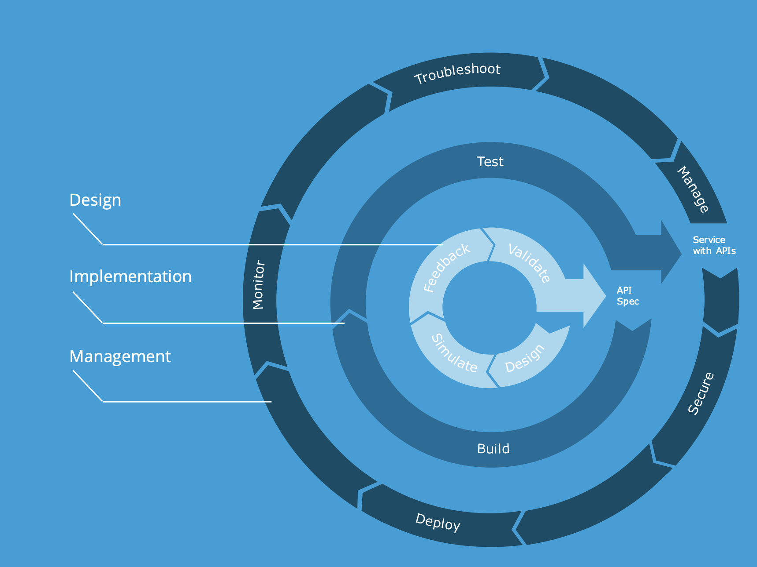
API Lifecycle
Design and develop the API.
Document the API clearly for developers.
Version and maintain the API as needed.

Slide 21
THANK YOU

Slide 22
Group Members
Yeabsra Albachew
Aziza Seid
Eden Teklil
Naol Kuma
Amanual Degu

